Slide 1
Course Code: CSE 4114
Course Title: Pattern Recognition Lab.
Title:
KNN base Mushrooms classification
Group member:
Name | ID
Ifteasam Islam Jahin | 0621930105101001
Most.Taslima Akter Juthi | 0621930205101005
Md. Faisal Akber | 0621930105101014
Presented To
Md. Tarequl Islam
Assistant Professor,
Department of Computer Science and Engineering

Slide 2
01
Introduction Of KNN
02
Literature review
03
Objective
Table of Contents
04
Methodology
05
Result and discussion
06
Conclusion
07
Limitation
08
Reference

Slide 3
Introduction Of KNN
The abbreviation KNN stands for “K-Nearest Neighbor”.
K-Nearest Neighbor is one of the simplest Machine Learning algorithms based on Supervised Learning technique.
K-NN algorithm assumes the similarity between the new case/data and available cases and put the new case into the category that is most similar to the available categories.
The algorithm can be used to solve both classification and regression problem statements.

Slide 4
Literature review
K. Thirunavukkarasu, et al.,[21] proposed a method to classify plant species using appropriate agent selection method using the Genetic Algorithm and using the K-nearest neighbor technique to classify the type of plants. The sample used for experiment consisted of 340 levels of 30 plant species. The results were performed using the K-nearest neighbor technique along and get 79.50% recall and 79.50% accuracy and precision 73.17%.

Slide 5
Objective
The main objective of the KNN algorithm is to predict the classification of a new sample point based on data points that are separated into several individual classes.
The purpose of this report will be to produce a predictor that can accurately determine if a mushroom is toxic or not based on its physical features.
To find out its recall, precision and F1 score.
To comparison between different cases of mushroom classification based on their accuracy.

Slide 6
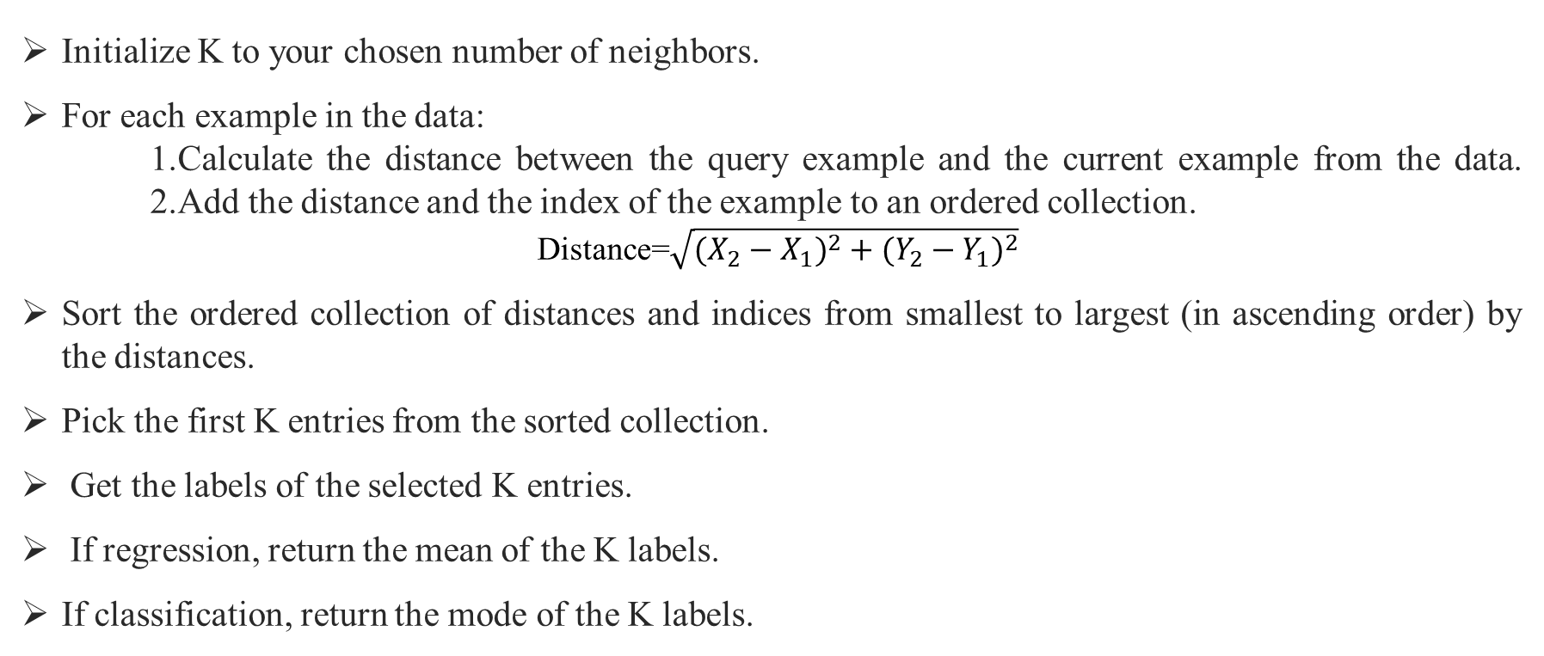
Methodology
Initialize K to your chosen number of neighbors.
For each example in the data:
1.Calculate the distance between the query example and the current example from the data. 2.Add the distance and the index of the example to an ordered collection.
Distance=$\sqrt{({X_{2}−X_{1})}^{2}+({Y_{2}−Y_{1})}^{2}}$
Sort the ordered collection of distances and indices from smallest to largest (in ascending order) by the distances.
Pick the first K entries from the sorted collection.
Get the labels of the selected K entries.
If regression, return the mean of the K labels.
If classification, return the mode of the K labels.

Slide 7
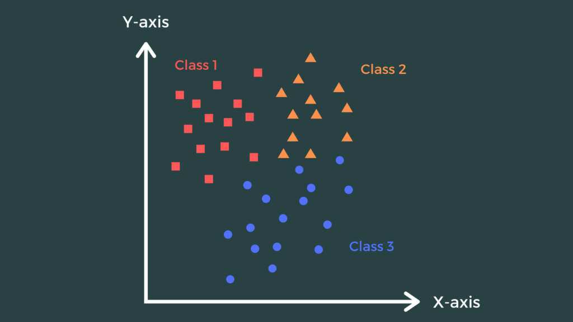
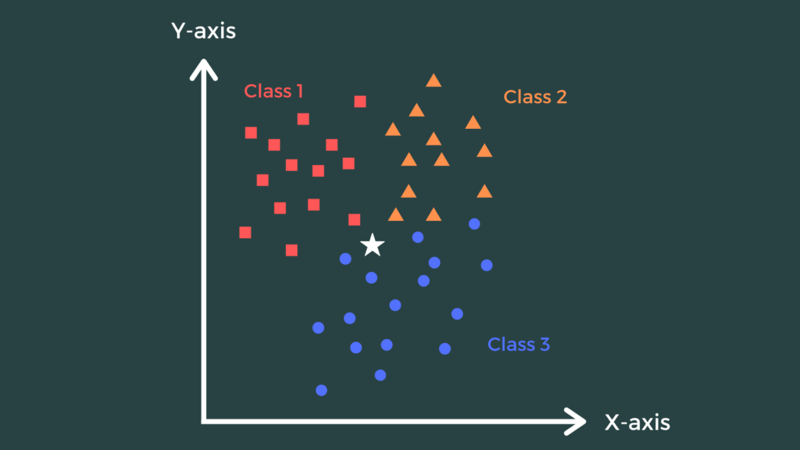
Example of KNN
Step:1
Step:2

Slide 8
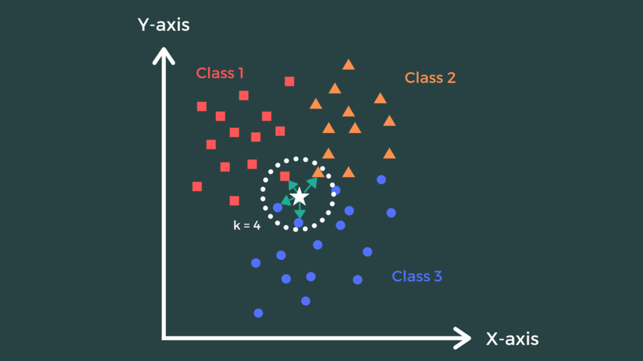
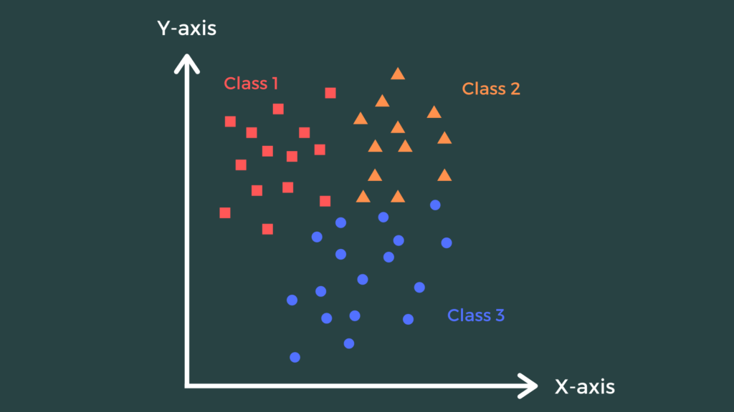
Example of KNN
Step:3
Step:4

Slide 9
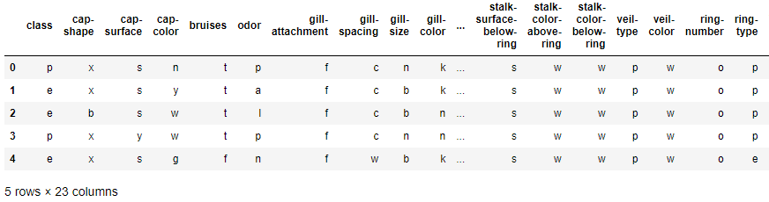
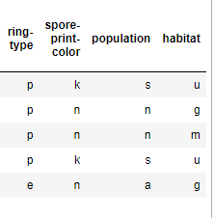
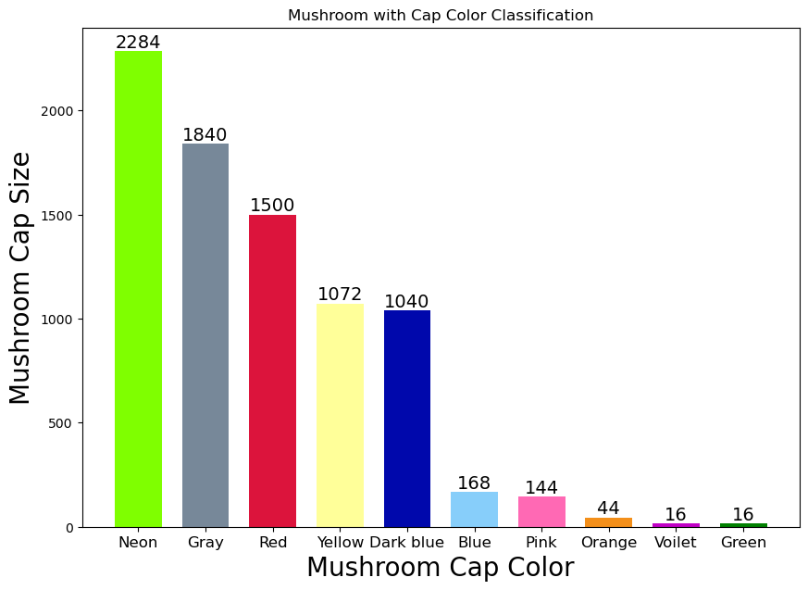
Result and discussion after implementation on Python
Fig 1: Table of Mushrooms Dataset.
Fig 2: Mushroom with cap color classification.

Slide 10
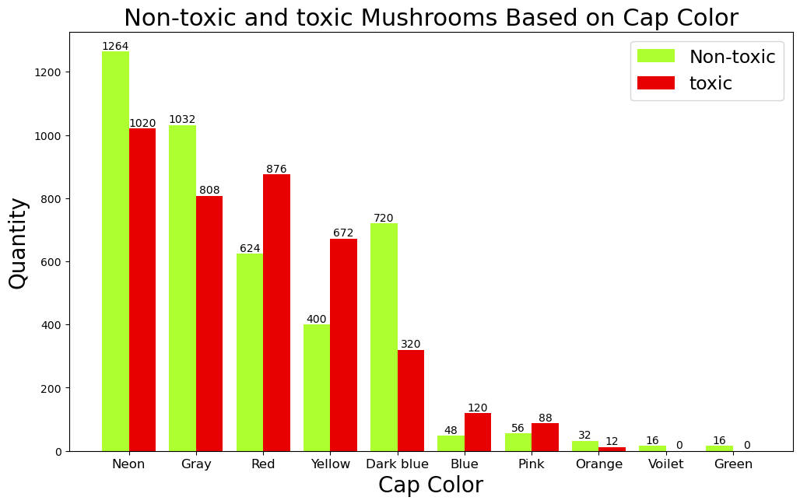
Result and discussion after implementation on Python
Fig 3: Non-toxic and toxic mushroom based on cap Color.

Slide 11
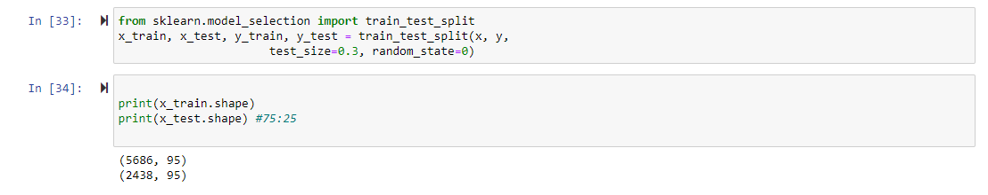
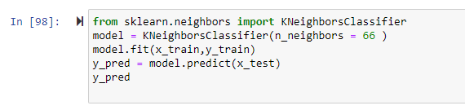

Result and discussion after implementation on Python
Some necessary codes are given below:

Slide 12
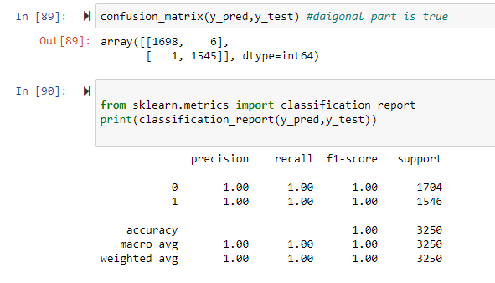
Result and discussion after implementation on Python
Some necessary codes are given below:

Slide 13
Result and discussion after implementation on Python
Fig 4: Comparison the different type of cases.

Slide 14
Conclusion
Our work focus to classify by physical characteristic mushroom between toxic and non-toxic. In addition, we comparison the efficiency with K-NN method with mushroom dataset. The mushroom data set consists of 23 feature attributes and 8124 record. All of them divided into two class as toxic and non-toxic. We compare different type of ‘K’ values and testing ratio for getting the highest accuracy rate. The result K-NN show 100% accuracy rate. The reason is this data set are numeric data with discrete values then suitable for K-NN, thus making the classification highly accurate.

Slide 15
Limitation
Doesn’t work well with a large dataset: Since KNN is a distance-based algorithm, the cost of calculating distance between a new point and each existing point is very high which in turn degrades the performance of the algorithm.
Doesn’t work well with a high number of dimensions: Again, the same reason as above. In higher dimensional space, the cost to calculate distance becomes expensive and hence impacts the performance.
Sensitive to outliers and missing values: KNN is sensitive to outliers and missing values and hence we first need to impute the missing values and get rid of the outliers before applying the KNN algorithm.

Slide 16
Reference
[1] E. S. Alkronz, K. A. Moghayer, M. Meimeh, M. Gazzaz, B. S. Abu-nasser, and S. S. Abu-naser, “Prediction of Whether Mushroom is Edible or Poisonous Using Back-propagation Neural Network .,” Int. J. Acad. Appl. Res., vol. 3, no. 2, pp. 1–8, 2019, [Online]. Available: http://www.ijeais.org/ijaar.
[2] A. Wibowo, Y. Rahayu, A. Riyanto, and T. Hidayatulloh, “Classification algorithm for edible mushroom identification,” 2018 Int. Conf. Inf. Commun. Technol. ICOIACT 2018, vol. 2018- Janua, pp. 250–253, 2018, doi: 10.1109/ICOIACT.2018.8350746.
[3] M. Husaini, “A Data Mining Based On Ensemble Classifier Classification Approach for Edible Mushroom Identification,” no. July, pp. 1962–1966, 2018.
[4] B. Tay, J. K. Hyun, and S. Oh, “A machine learning approach for specification of spinal cord injuries using fractional anisotropy values obtained from diffusion tensor images,” Comput. Math. Methods Med., vol. 2014, 2014, doi: 10.1155/2014/276589.

Slide 17


